Slide 1
Design GUI for nanochannel data analysis
Work Summary
Until 01/07/2025
Yichao Wang

Slide 2
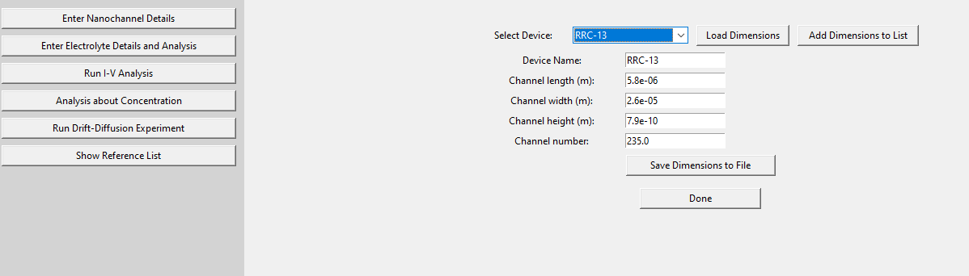
Button 1- Enter Nanochannel Details
Layout of Button 1- Enter Nanochannel Details

Slide 3
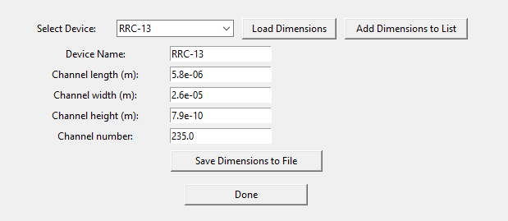
Button 1- Enter nanochannel details
Load dimensions from drop down list
Save dimensions to drop down list
Save dimensions to local drive

Slide 4
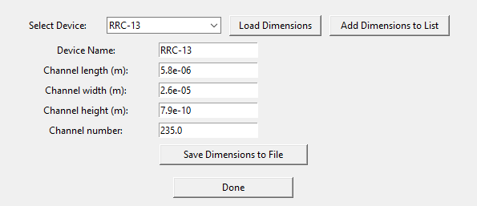

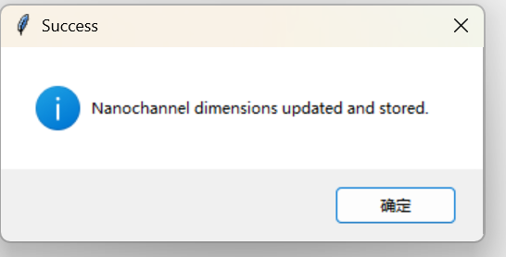
Button 1- Enter nanochannel details
Note: Remember, When finished, Click Done to save and process the nanochannel details.

Slide 5
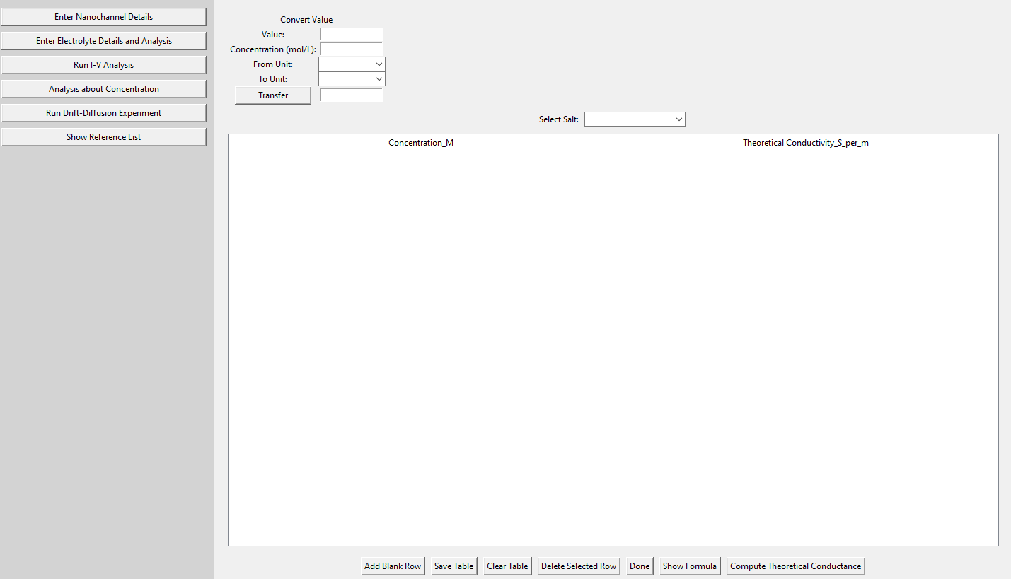
Button 2 – Enter Electrolyte Details and Analysis
Layout of Button 2 – Enter Electrolyte Details and Analysis

Slide 6
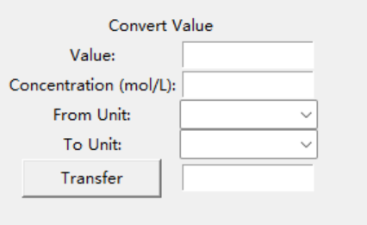
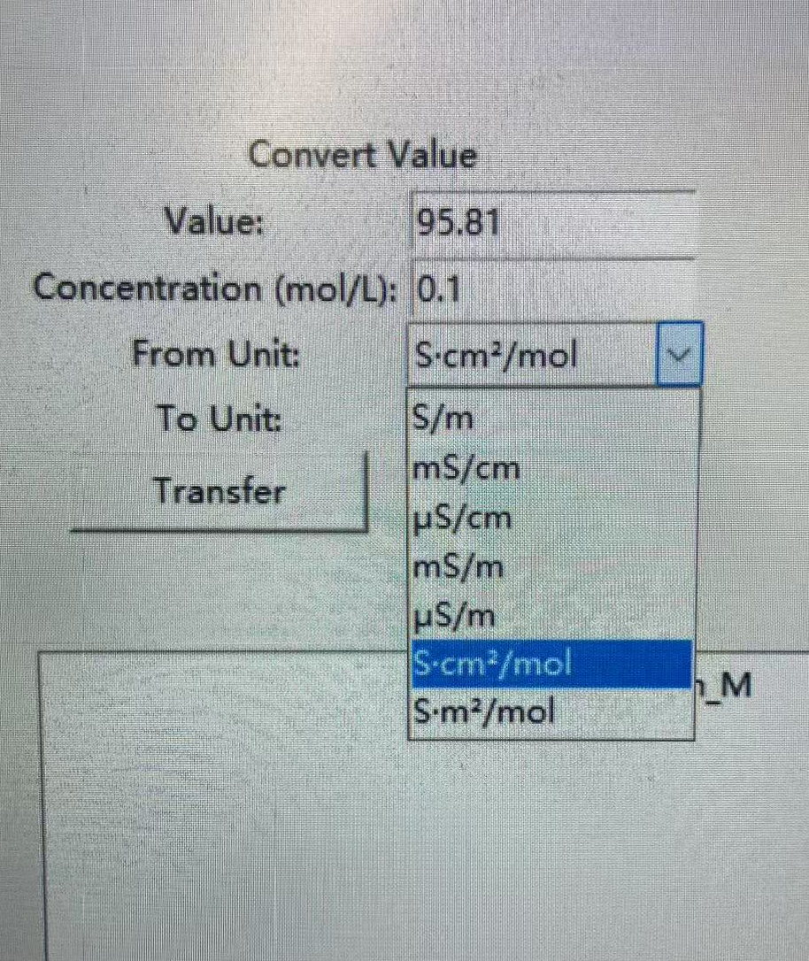
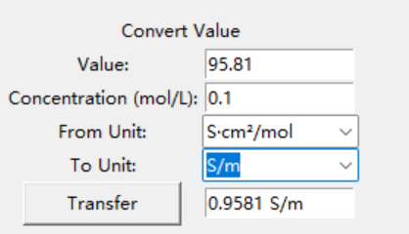
Button 2 – Enter Electrolyte Details and Analysis
Unit converter function
Unit list (Can be customised)

Slide 7
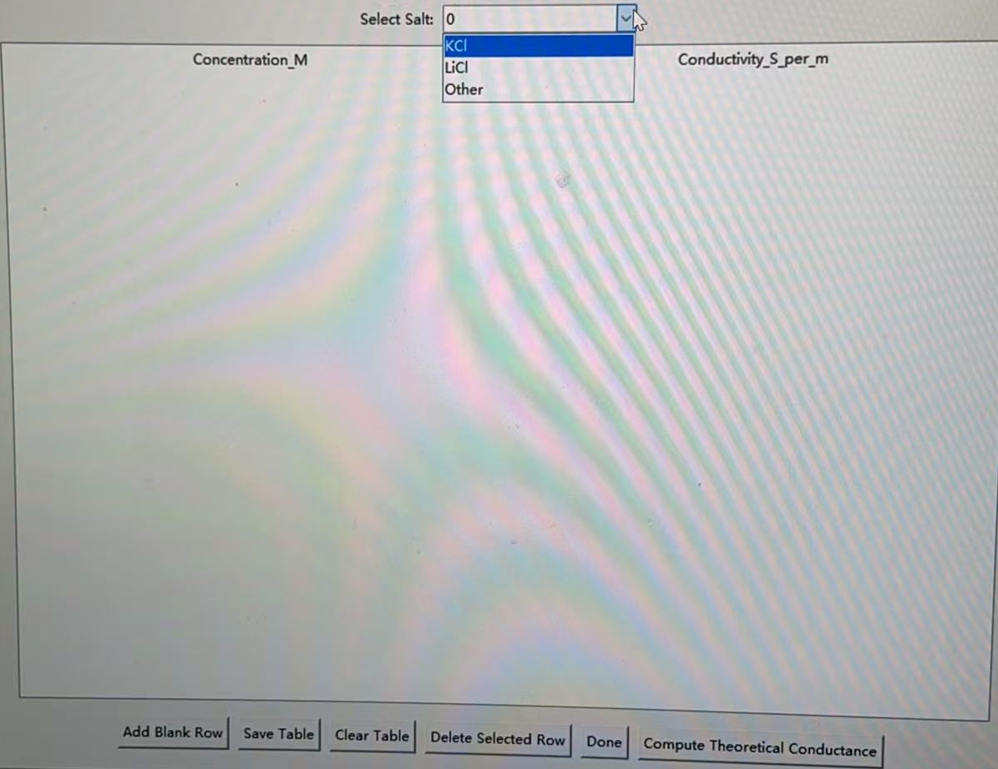
Button 2 – Enter Electrolyte Details and Analysis
Select salt (which I already loaded inside the code, can be also be appended)
After selection, the following table will be automatically filled

Slide 8
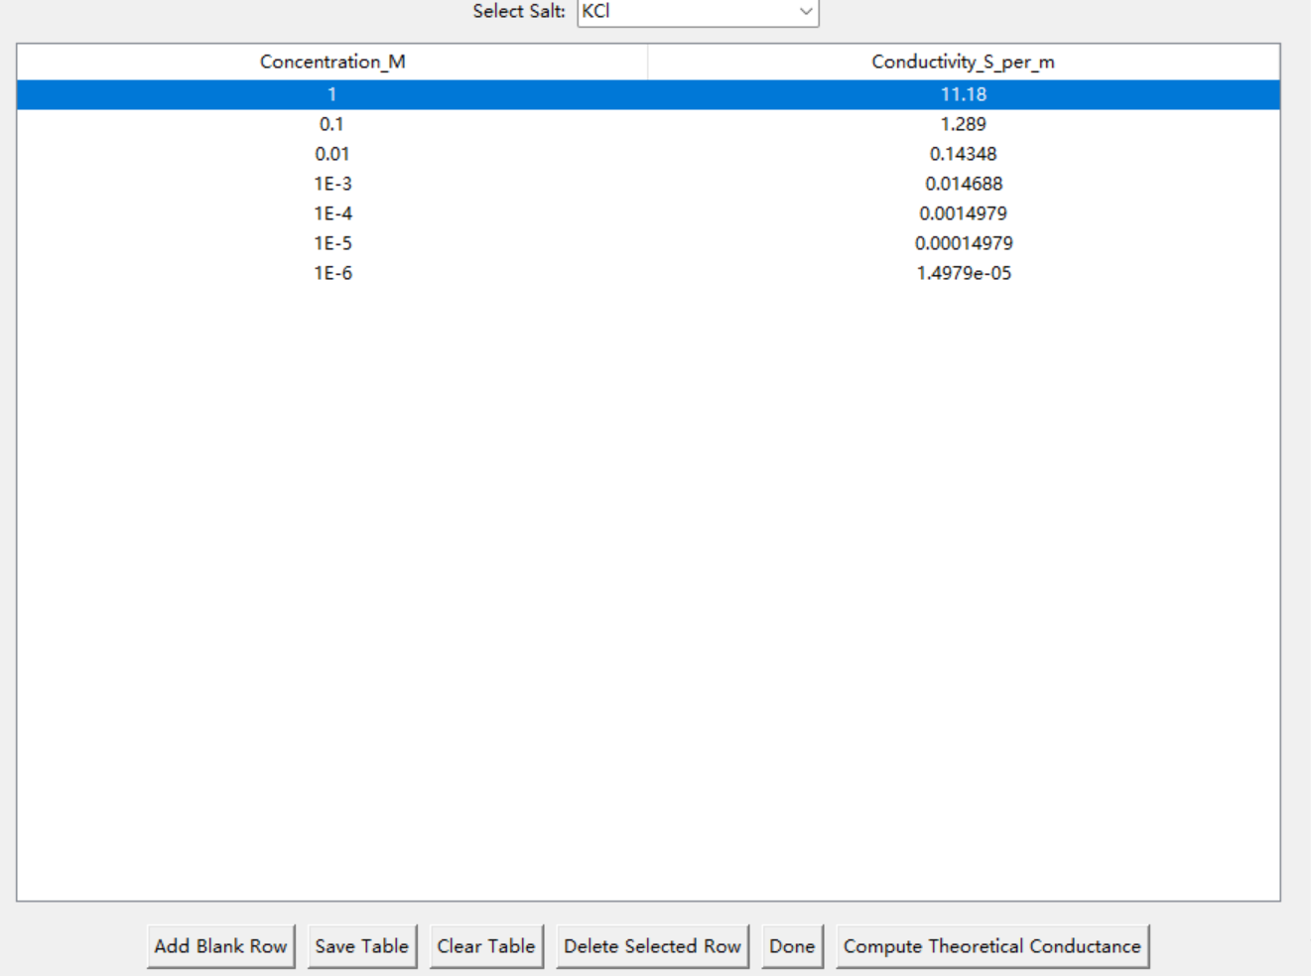
Button 2 – Enter electrolyte details
After selection, the following table will be automatically filled

Slide 9
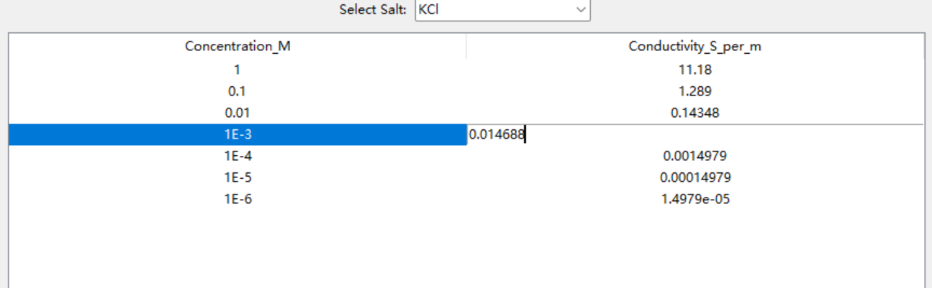
Button 2 – Enter electrolyte details
Table is editable for updates, press ENTER to save change

Slide 10
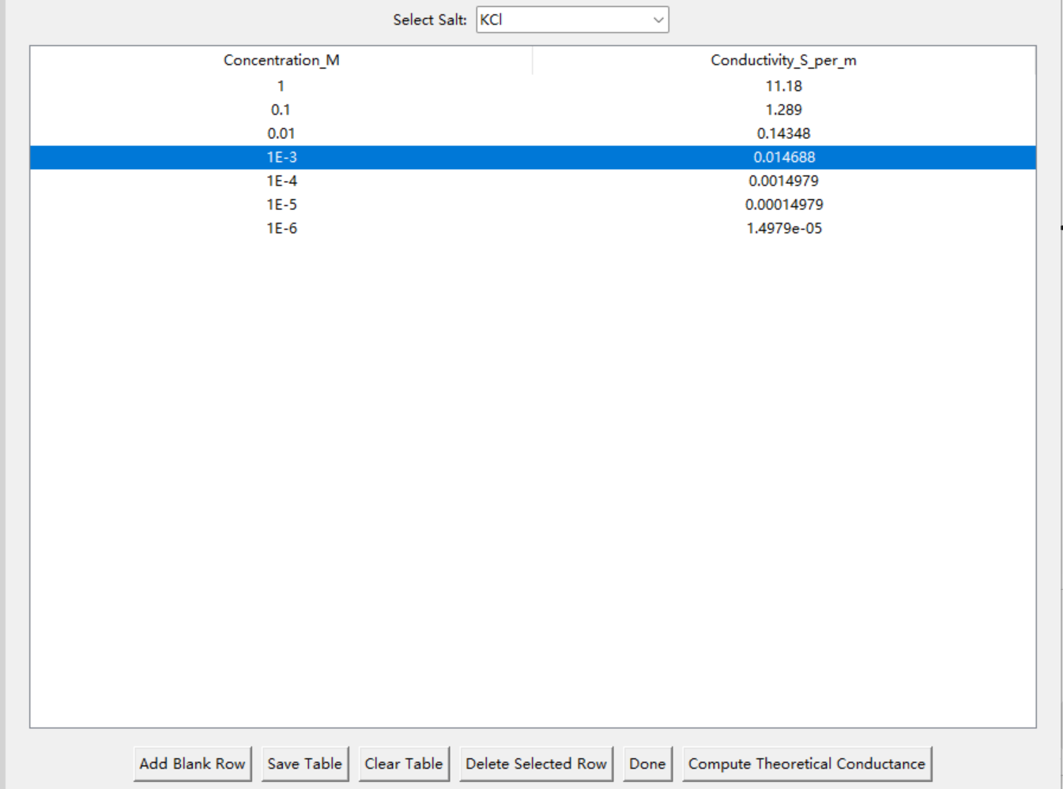
Button 2 – Enter electrolyte details
Selected row can be deleted
Clear table can clear all the data in the table

Slide 11
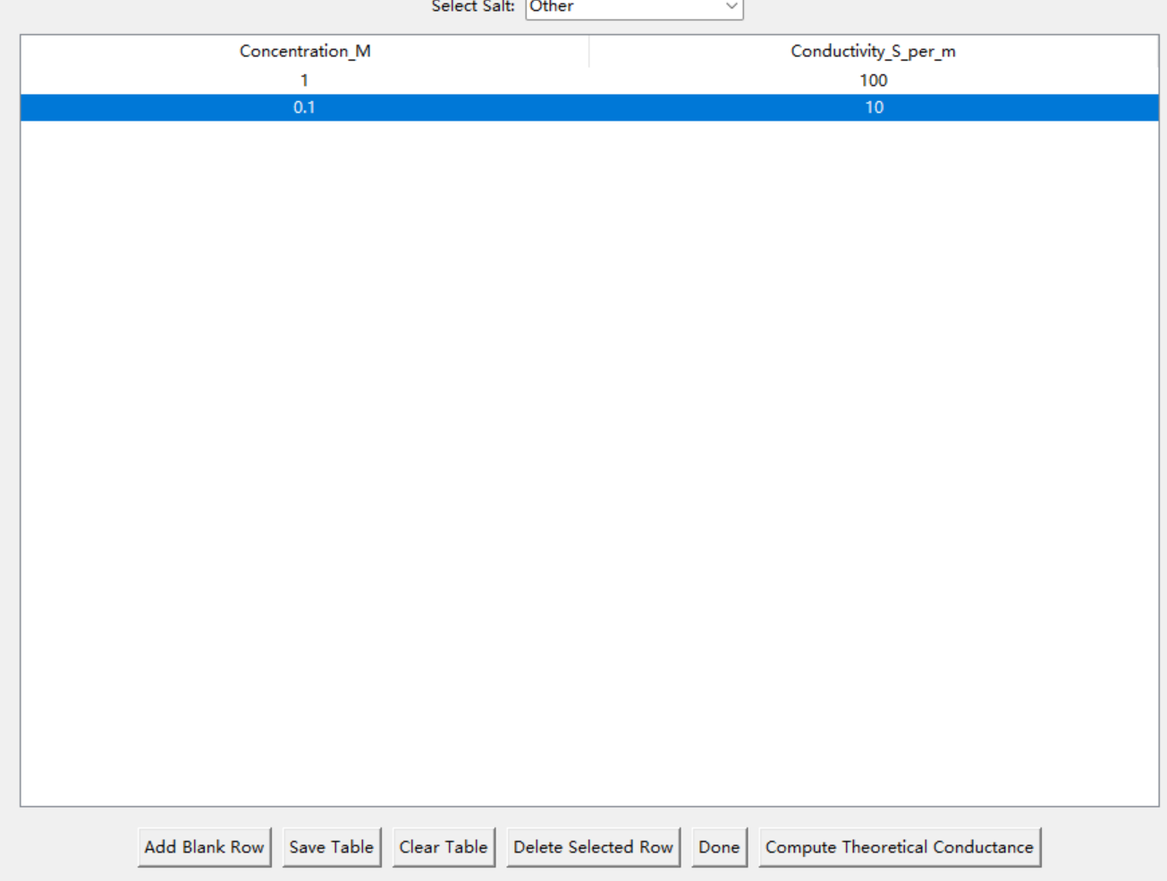
Button 2 – Enter electrolyte details
If the salt’s properties are not pre-loaded, user need to input manually
Also press Enter to save change
Add a new row

Slide 12

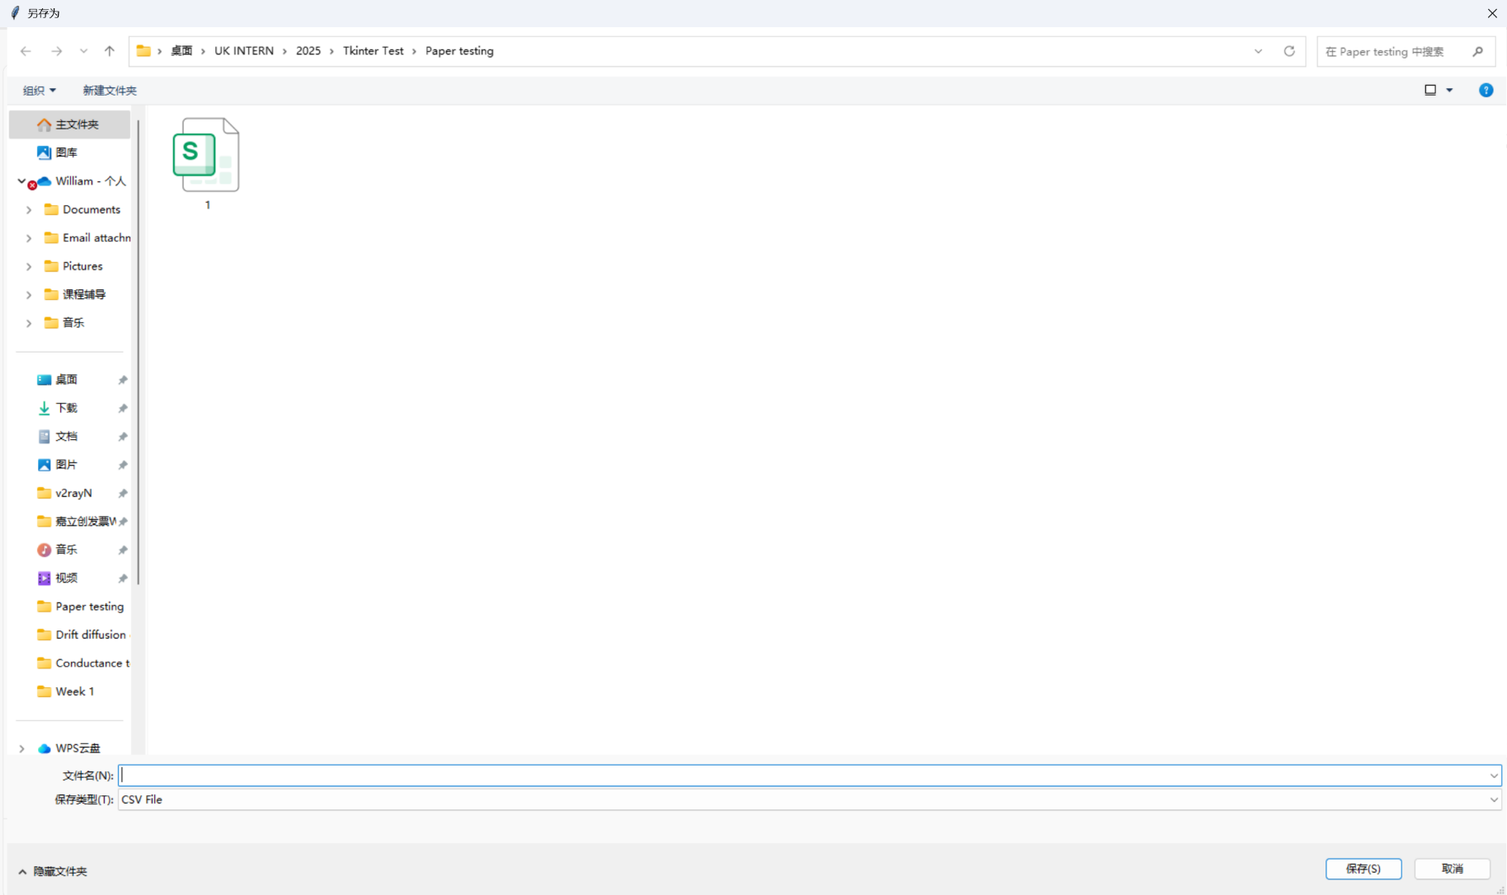
Button 2 – Enter electrolyte details
After press save table, the current table can be saved interactively, user can name a file name, choose location

Slide 13
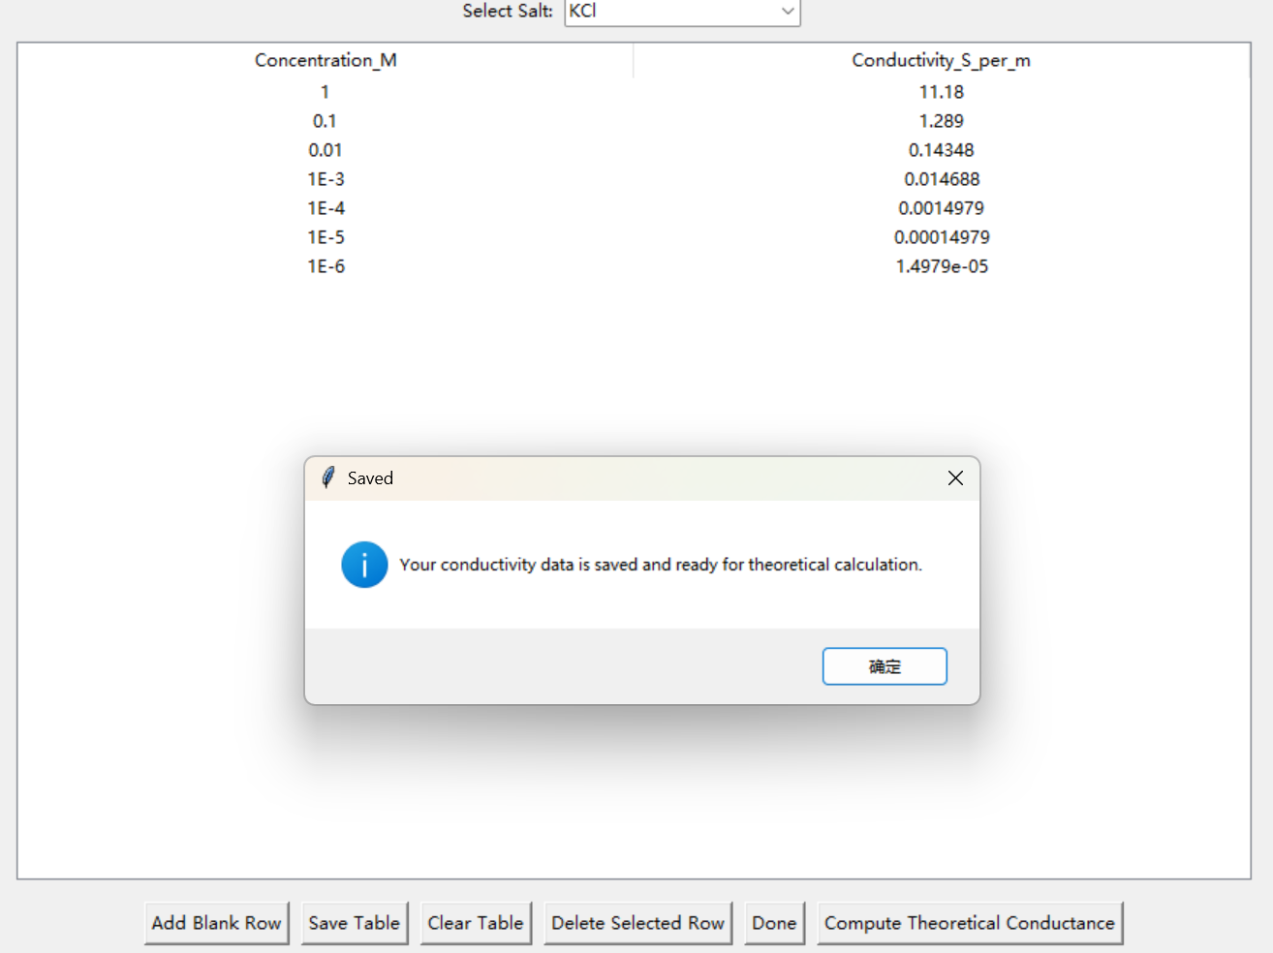
Button 2 – Enter electrolyte details
When user is satisfied with the table, press done to save change and can be proceed to next step

Slide 14
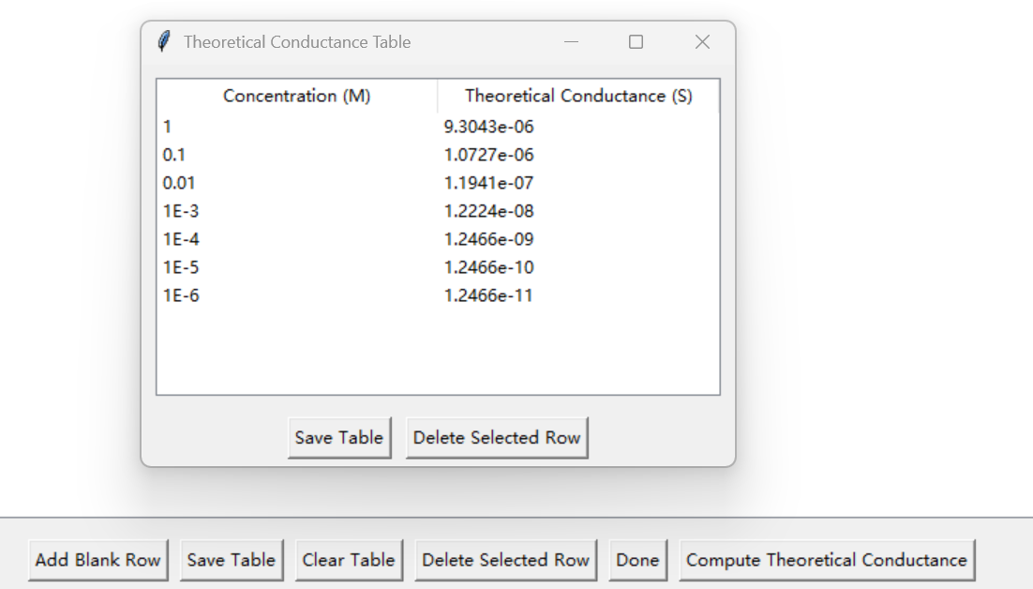
Button 2 – Enter electrolyte details
After pressing the button, it would create a new window to show the corresponding conductance

Slide 15
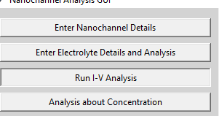
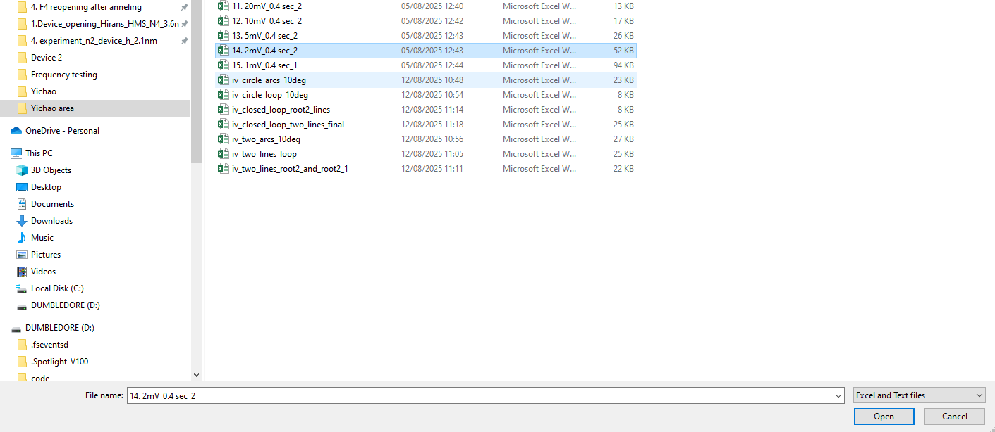
Button 3 – Run IV Analysis
When you click Run IV Analysis, a file picker opens—select the data file to analyze.

Slide 16
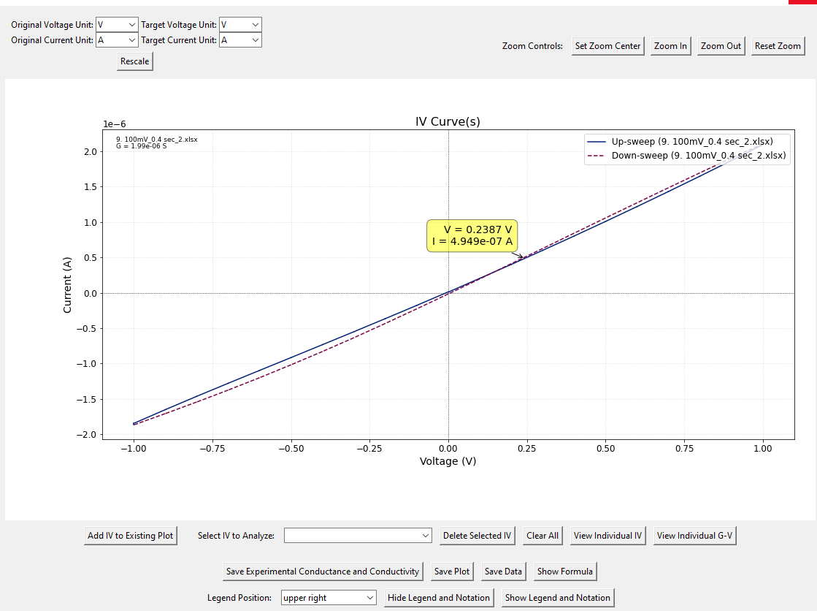
Button 3 – Run IV Analysis
Layout of Main IV Analysis window
Distinguishes sweep direction

Slide 17
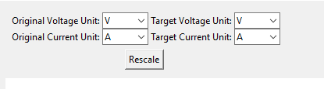


Button 3 – Run IV Analysis
This region scale the axis
Zoom controls for the main plot: set center, zoom in/out, reset.
Save data, and edit the legend of the graph

Slide 18
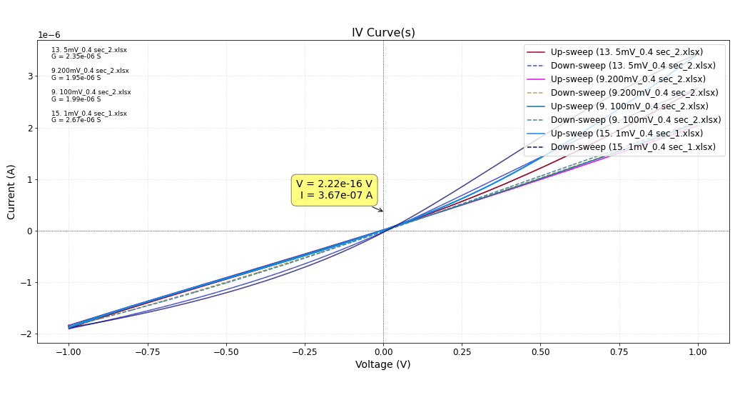
Button 3 – Run IV Analysis
Add Multiple IV Curves to Main Plot
Delete the IV already presented in main plot
Drop down list to select particular IV

Slide 19
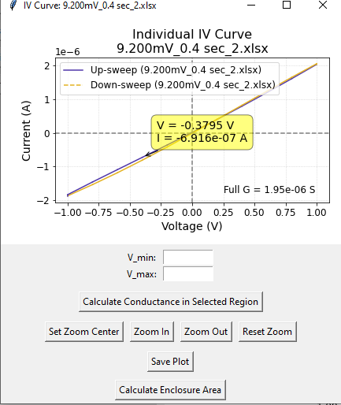
Button 3 – Run IV Analysis
Press “View Individual IV” to launch a new window that retains the full-range conductance value and zoom controls.

Slide 20
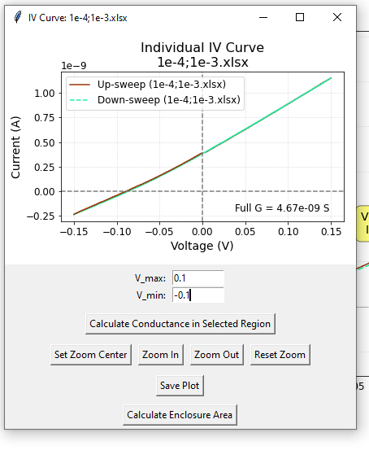
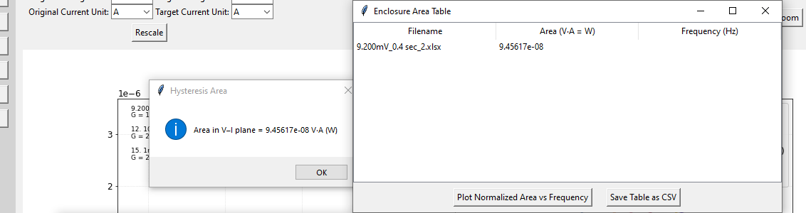
Button 3 – Run IV Analysis
Clicking Calculate Enclosed Area opens two windows:
a plot and an editable table. You can add rows to the table with the corresponding frequency.
The table can also be saved

Slide 21
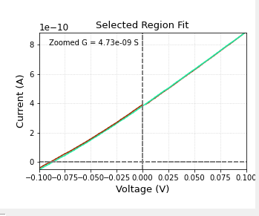

Button 3 – Run IV Analysis
Enter a voltage range, then click Calculate Conductance in Selected Region to display a zoomed plot and the corresponding conductance (G).
After calculation, two buttons appear: Save Left Plot and Save Right Plot

Slide 22
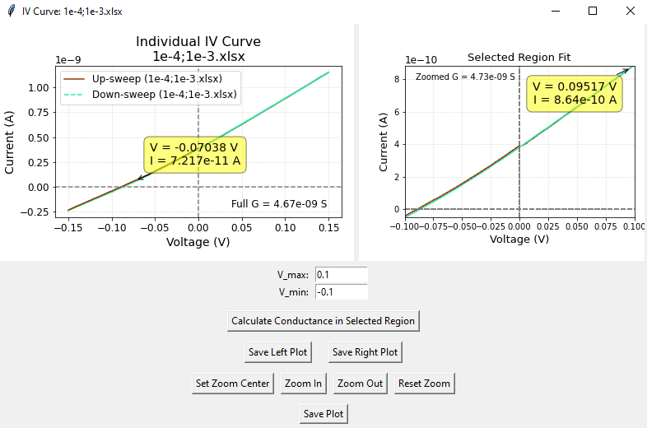
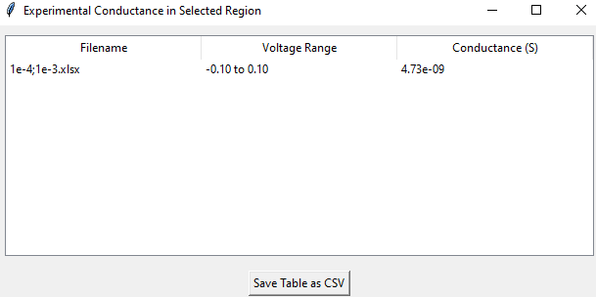
Button 3 – Run IV Analysis
Layout after pressing Calculate Conductance in Selected Region
An editable results table pops up with the plot, storing the conductance for the selected (zoomed) range.

Slide 23
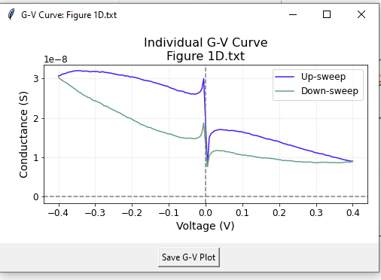
Button 3 – Run IV Analysis
After press View individual G-V, it would launch a new window with G-V analysis

Slide 24
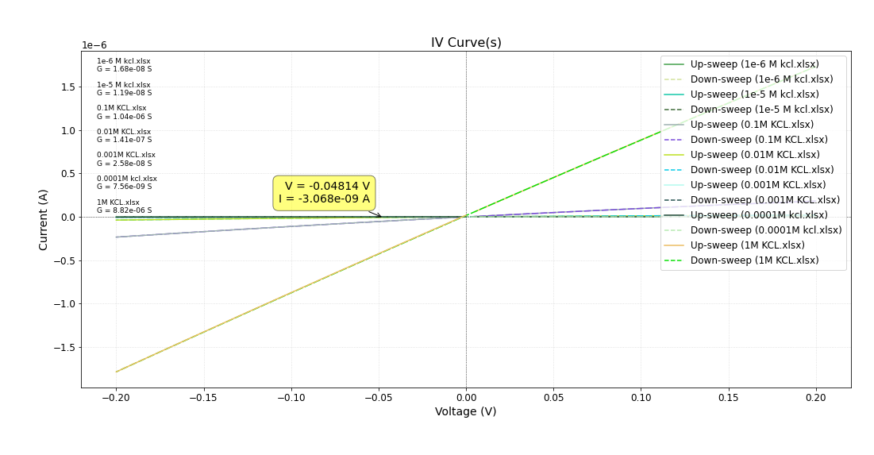
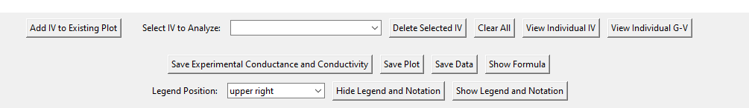
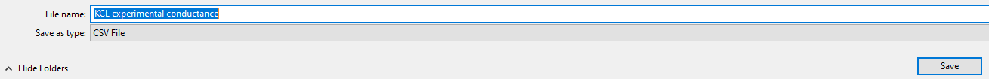
Button 3 – Run IV Analysis
After adding all IV curves, click Save Experimental Conductance & Conductivity. A save dialog opens to export all conductance values and computed conductivity.

Slide 25
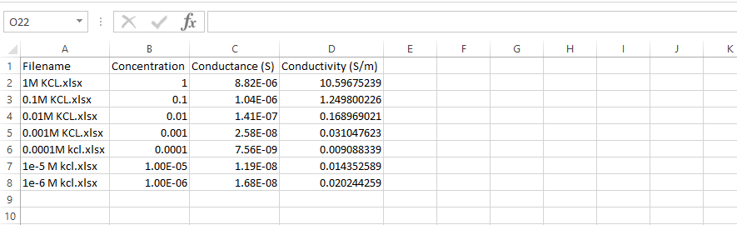
Button 3 – Run IV Analysis
Saved table preview — sorted from high to low concentration.
Important: Used for conductivity/conductance vs. concentration analysis.

Slide 26
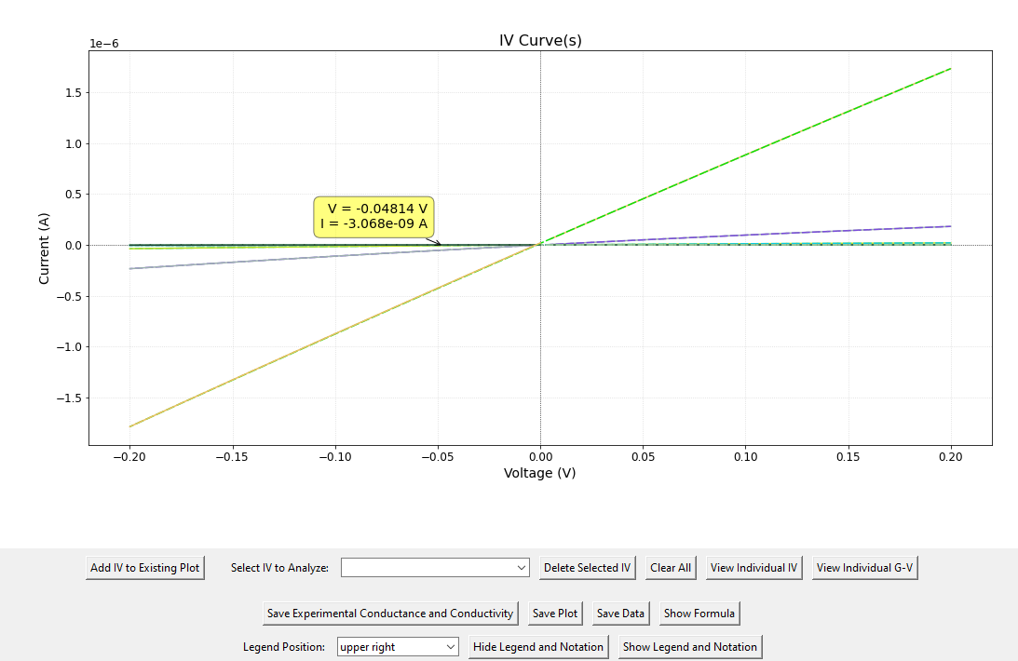
Button 3 – Run IV Analysis
Click Hide Legend & Notation to hide the legend and annotations; click Show… to restore them.
Use drop-down list to select the position of the legend

Slide 27
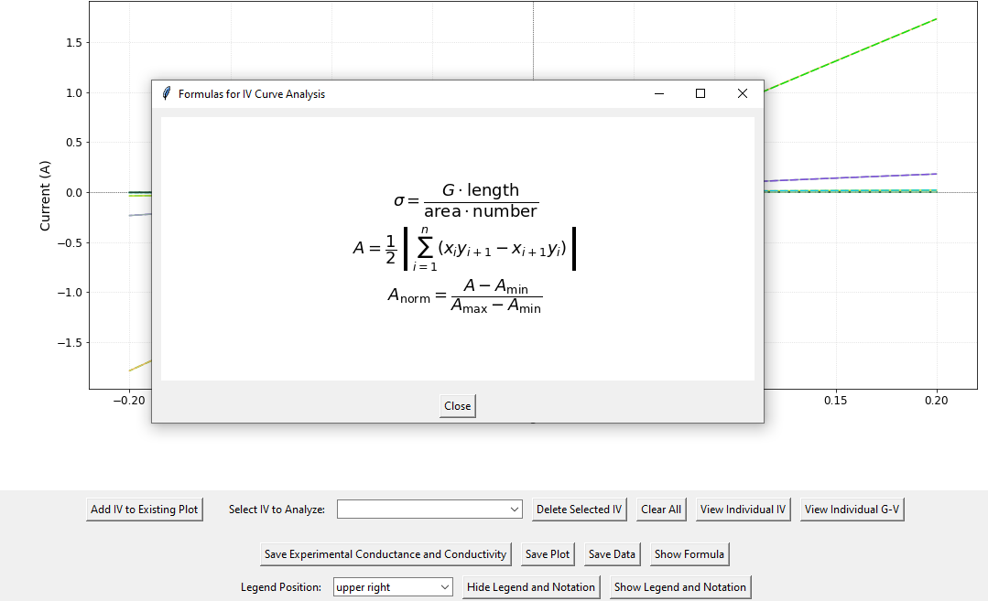
Button 3 – Run IV Analysis
Show Formula, displays a brief formula overview. For detailed explanations, open “Show Reference List.”

Slide 28
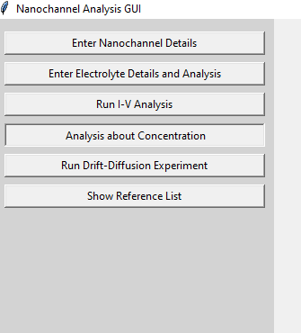
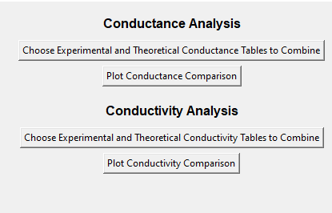
Button 4 – Analysis about Concentration
Press Analysis about Concentration would open the Conductance Analysis and Conductivity Analysis

Slide 29
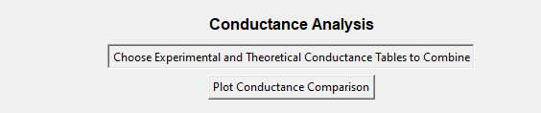
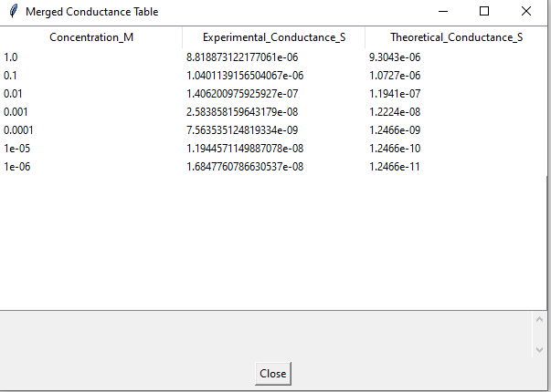
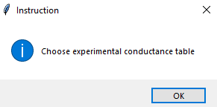
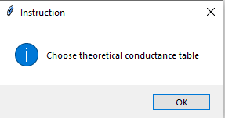
Button 4 – Analysis about Concentration
5. Press Plot Conductance Comparison would plot conductance vs. concentration
1. Press this button
2. Select experimental conductance data, from I-V Analysis
3. Choose theoretical conductance data from Electrolyte Details and Analysis
4. Press ok would create a merged conductance table

Slide 30
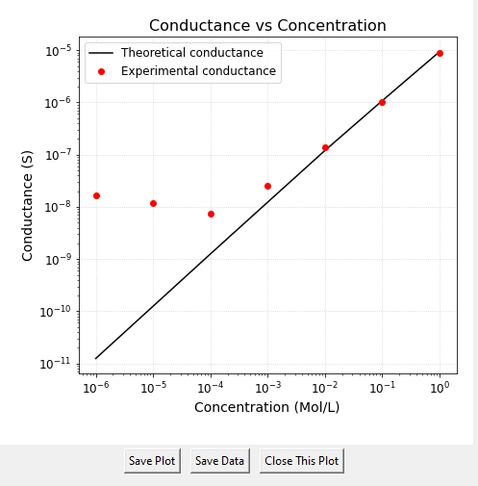
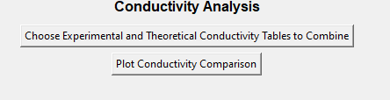
Button 4 – Analysis about Concentration
Example of plotted graph
Note: Conductivity analysis uses the same workflow as conductance analysis.

Slide 31
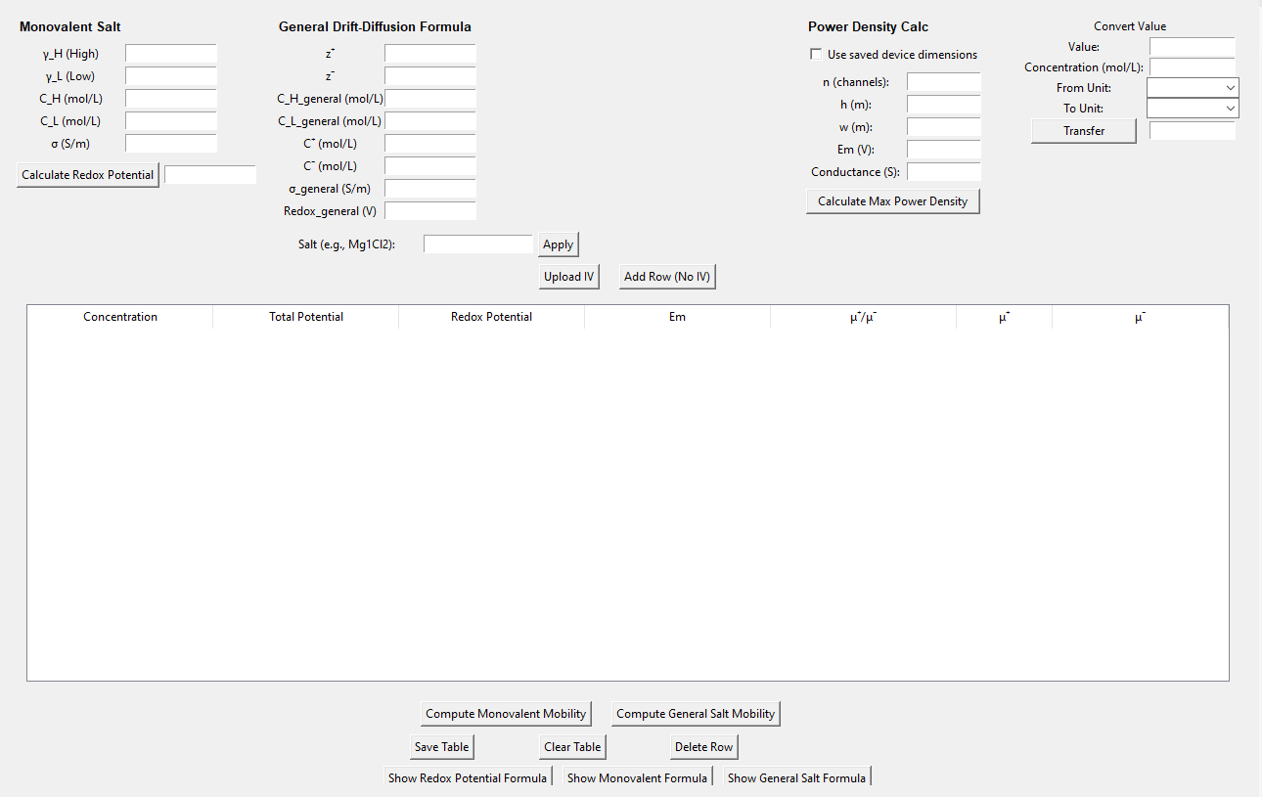
Button 5 – Run Drift–Diffusion Experiment
Overall layout of this function

Slide 32
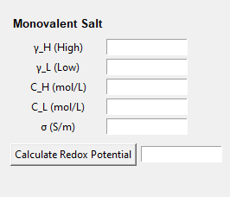

Button 5 – Run Drift – Diffusion Experiment
Input Frame Guide:
This part is for monovalent salt. The user can input all the blank box to calculate the Redox potential.
Or the user can directly type in the redox potential in the table. (Add row first if no IV)
Tooltip: These three values are mandatory.
This part bonds to this button to calculate mobility
Note: C_H, C_L and σ are required inputs

Slide 33
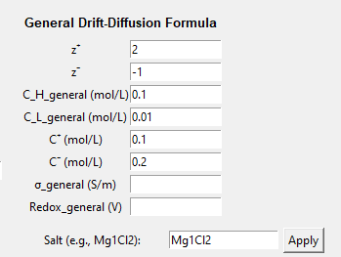
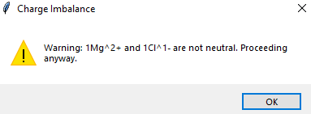
Button 5 – Run Drift – Diffusion Experiment
Input Frame Guide:
This part is for General salts.
The user can use the Salt Apply to automatically fill z+, z-, c+ and c- after inputting C_H and C_L.
Always
required
Salt Apply includes a built-in salt library. An imbalance in the entered salt’s charges triggers a warning. The library is expandable.
Redox potential can be put either here or directly in the table

Slide 34
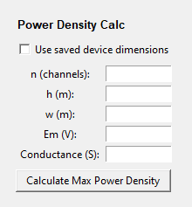
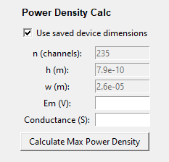
Button 5 – Run Drift – Diffusion Experiment
This part is for power density calculation
Choose manual entry or tick Use saved device dimensions.
Selecting Use saved device dimensions auto-fills the values and grays out the inputs.
Calculator Mode: Em and Conductance can be typed manually.
Analyser Mode: Em and Conductance can be copied from uploaded IV

Slide 35
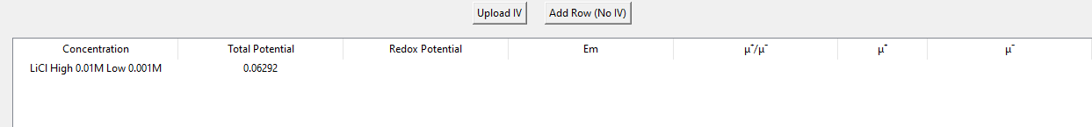
Button 5 – Run Drift – Diffusion Experiment
Calculator mode: Press Add Row (No IV) to add a blank row.
Just type in the Etotal, Eredox, Em concentrations and conductivity.
Click the corresponding calculation button to compute ion mobility.
All the boxes in the box is editable, remember to press Enter to save change.
Remember to put the required inputs in the input frame.
Always
required

Slide 36
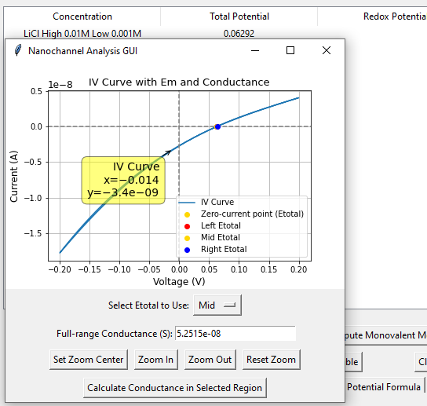
Button 5 – Run Drift – Diffusion Experiment
Analyser Mode:
1. Press Upload IV to select Drift-Diffusion I-V data that needs to be measured.
A new window opens with Concentration auto-filled (from the filename);
E_total and full-range conductance are computed automatically

Slide 37


Button 5 – Run Drift – Diffusion Experiment
Analyser Mode:
1.1 The GUI provides 3 different zero current voltage points (Etotal).
The Midpoint row is auto-filled to the table.
Selecting Left E_total or Right E_total inserts a new blank row with the chosen E_total prefilled.

Slide 38

Button 5 – Run Drift – Diffusion Experiment
Analyser Mode:
1.2 Click Calculate Conductance in Selected Region to open a new window. Enter your voltage range and press Calculate to see the zoomed plot and conductance (G).
Useful for power density calculation

Slide 39

Button 5 – Run Drift – Diffusion Experiment
It also has the brief demonstration of the formula, detailed explanation is still in Show Reference List

Slide 40

Button 6 – Show Reference List
This function opens in a separate window and won’t interrupt the main workflow.
Includes detailed method explanations with links to the original papers/books.

Slide 41




Additional Function – Cheer Up Words
On open and close, a random cheer-up message appears (four built-ins, expandable).
Bring warmth to scientific research.

Slide 42

Maintain & Add Features
In Spyder, go to View → Panes and check Outline (require to be ticked).
It would display a Table of Contents you can use to jump between sections.

Slide 43


Maintain & Add Features
This is the Navigable Table of Content for this GUI:
Subheadings organize features into sections so you can jump straight to any function.

Slide 44
Note: There is a scale – modified version, the user can custom the scale factor.
But it is very slow.

